Slide 1
Trophic Levels

Slide 2

By the end of the lesson, you should be able to:
1. | Explain what trophic levels are.
2. | Calculate how much energy moves between trophic levels.

Slide 3
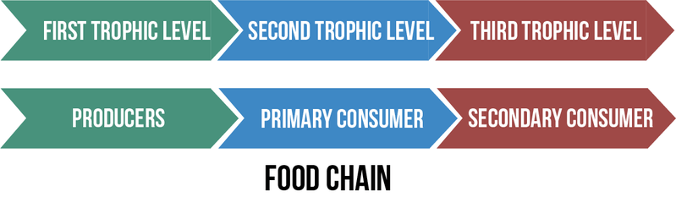
A trophic level is an organism's position in a food chain, web or pyramid.
It is an organism's feeding level.

Slide 4
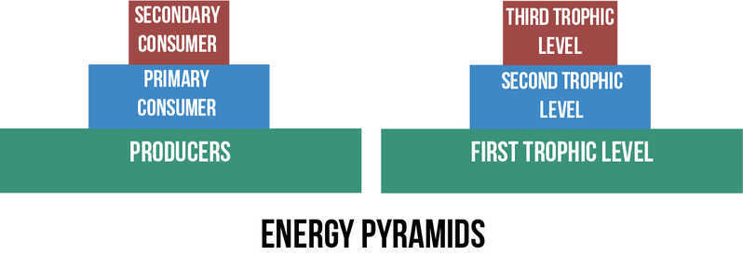
An energy pyramid is another way to show energy flow from one trophic level to another.

Slide 5
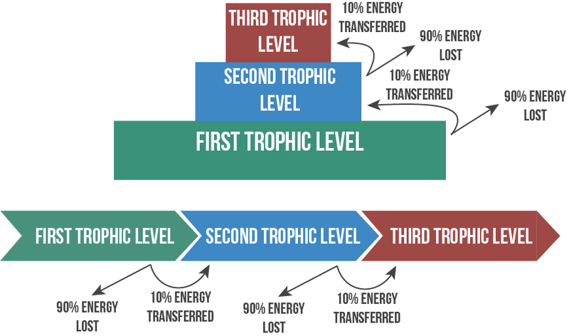
Only 10% of the energy in one trophic level is transferred to the next.
The rest is lost to the environment as heat or waste products.

Slide 6
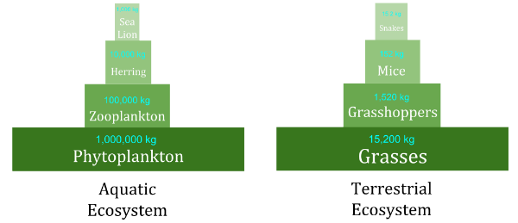
As you go up the trophic levels, the total mass of the organisms tends to decrease.
This is often represented as a pyramid of biomass, like the ones shown below.
This is because only about 10% of the energy in one trophic level is passed on to the next. There is less energy to support consumers than what the producers can provide.

Slide 7
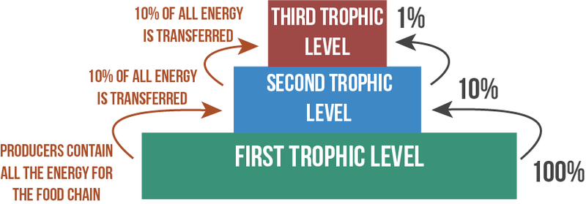
Only about 10% of the available energy passes from one trophic level to the next.
Therefore, we can work out how much energy each trophic level receives.
Only 1% of a producer's energy makes it to the second order consumers in a given ecosystem. Food chains do not usually contain more than four trophic levels, because there isn't enough energy left over to support a fifth level.

